Slide 1
CCNA (200-125)
IPv6 ROUTING
Instructor:
Muhammad Naeem
(MSIT/RHCE/CCNP/CCNA/MCSE)
Cell: 0345-5238281
E-Mail: mna571@yahoo.com

Slide 2
Objectives: IPv6 Routing Prototocols
IPv6 Routing Types
Static
RIPng (RFC 2080)
OSPFv3 (RFC 2740)
IS-IS for IPv6
MP-BGP4 (RFC 2545/2858)
EIGRP for IPv6
The IPv6 unicast-routing command is required to enable IPv6 before any routing protocol is configured.

Slide 3
RIPng
Similar to IPv4
Distance Vector
Radius of 15 hops
Split horizon
Poison Reverse
Based on RIPv2
Updated
IPv6 prefix, next hop IPv6 address
Multicast group of FF02::9 the all rip routers multicast group as the destination for RIP updates
IPv6 used for transport

Slide 5
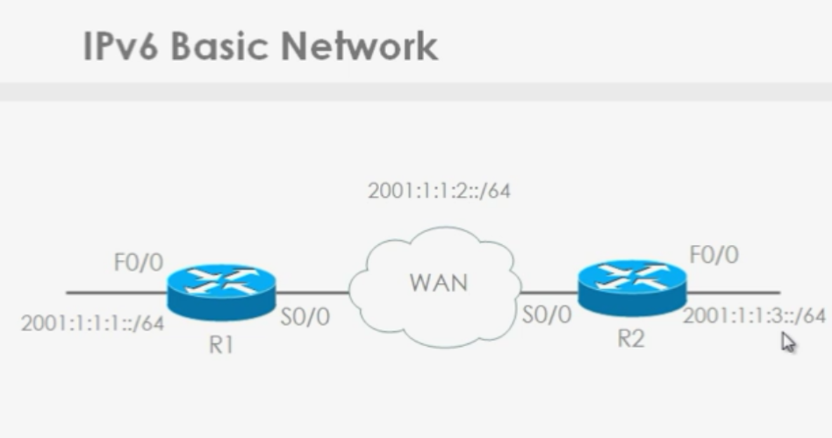

Slide 6
IPv6 basic configuration
On Router1: ------------------ R1(config)# ipv6 unicast-routing R1(config)# int f0/0 R1(config-if)# ipv6 add 2001:1:1:1::1/64 R1(config-if)# no shut R1(config-if)# int s0/0 R1(config-if)# ipv6 add 2001:1:1:2::1/64 | On Router2: ----------------- R2(config)# ipv6 unicast-routing R2(config)# int f0/0 R2(config-if)# ipv6 add 2001:1:1:3::1/64 R2(config-if)# no shut R2(config-if)# int s0/0 R2(config-if)# ipv6 add 2001:1:1:2::2/64

Slide 8
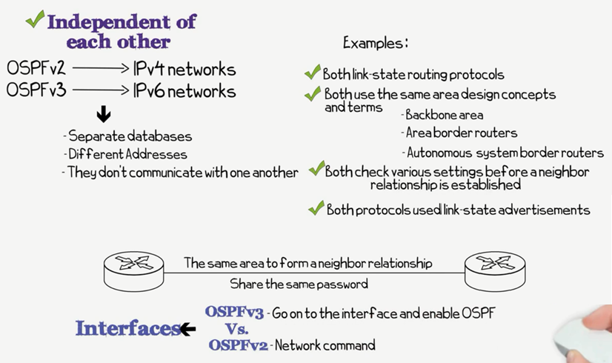
OSPFv2 vs OSPFv3

Slide 9
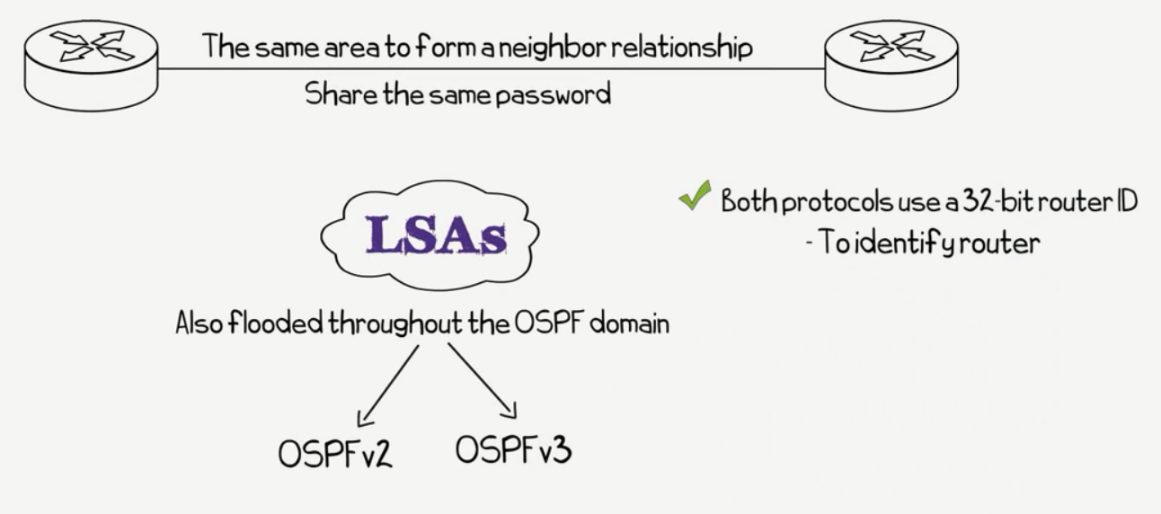

Slide 10
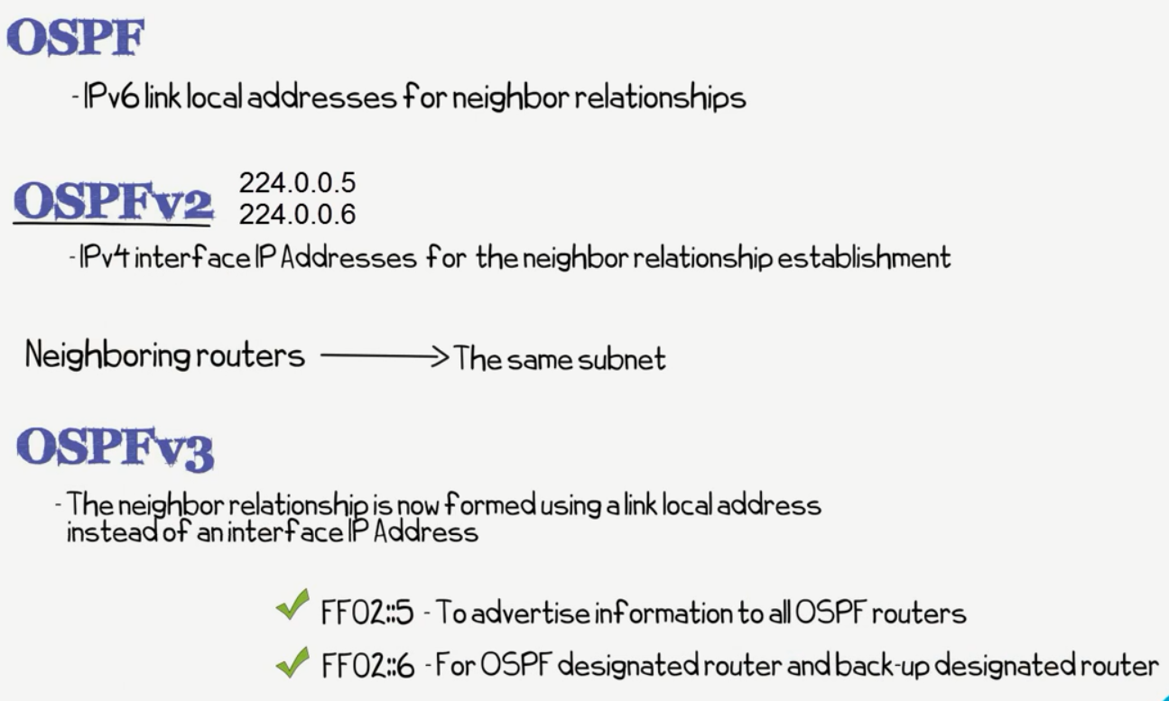

Slide 11
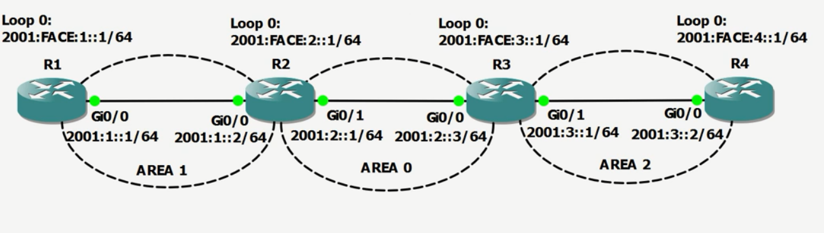
OSPFv3: Lab Scenario

